Slide 1

House Price Prediction Project
End-to-End Machine Learning System

Slide 2



Executive Summary
ML-Powered Estimates
End-to-End Pipeline
Interactive Predictions
Our system accurately estimates house prices based on various property features.
From data preprocessing to model deployment, we've built a robust, automated pipeline.
A user-friendly Streamlit application allows for real-time, interactive house price predictions.
This project showcases a complete machine learning solution, designed for scalability and ease of use in real estate valuation.

Slide 3
Project Overview
Dataset
Model
Deployment
Artifacts
Kaggle’s Ames Housing (train.csv)
RandomForestRegressor from scikit-learn
Interactive web application using Streamlit
Trained pipeline saved as .pkl
Comprehensive real estate features
Metadata for consistent inference
Integrated into a seamless prediction pipeline
Enables practical use and demonstration
Our objective was to develop a reliable and accessible house price prediction tool.

Slide 4



Data Preparation & Feature Engineering
Feature Derivation
HouseAge = YrSold – YearBuilt for a more relevant temporal feature.
Target Variable
SalePrice used as the primary prediction target.
Numeric Data Handling
Median imputation for missing values, followed by scaling.
Categorical Data Handling
Mode imputation and one-hot encoding applied.
These steps ensure all input data is clean, consistent, and optimally formatted for the machine learning model, supporting robust predictions.

Slide 5

Model Training & Evaluation
Algorithm & Pipeline
Validation & Metrics
RandomForestRegressor with 100 decision trees for robust prediction.
Standard 80/20 train-test split for evaluation.
Key metrics: Mean Squared Error (MSE) and R² Score, reported in console.
Integrated preprocessing steps directly into the model pipeline for seamless execution.
The final trained pipeline is serialized as a .pkl file for deployment.
This systematic approach guarantees model integrity and readiness for real-world inference.

Slide 6

Streamlit Application
Intuitive User Inputs
Users can easily enter key property features like Year Built, Year Sold, Overall Quality, and Living Area.
Seamless Backend Integration
The app loads the saved ML pipeline, performs necessary preprocessing on user inputs, and generates predictions.
Instant Price Display
Predicted Sale Prices are displayed immediately, providing quick insights.
Robust Missing Value Handling
Designed to gracefully handle missing input values, ensuring consistent predictions.
This interactive interface transforms a complex ML model into an accessible tool for property valuation.

Slide 7
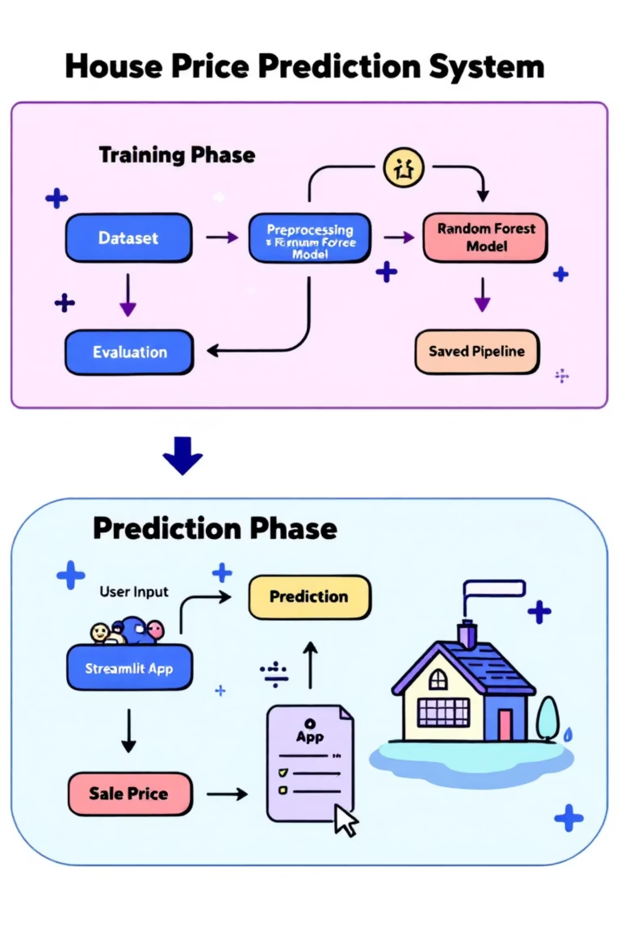
System Architecture
This diagram illustrates the logical flow from data ingestion to model deployment and inference.
Training Phase
Prediction Phase
Raw Dataset undergoes rigorous Preprocessing.
User Input collected via the Streamlit App.
Data feeds into the Random Forest Model for learning.
Input data receives consistent Preprocessing.
Processed data used by the model for Prediction.
Performance is assessed through Evaluation metrics.
Final Sale Price displayed to the user.
The validated model is saved as a Pipeline.

Slide 8





Key Features & Benefits
Complete ML Pipeline
Robust Data Handling
Modular Design
Automated workflow from raw data to deployed application, minimizing manual intervention.
Efficiently manages missing values and categorical features for consistent predictions.
Components are reusable and interchangeable, enabling easy updates and expansions.
Intuitive Streamlit UI
Persistent Model
Provides a simple and accessible interface for non-technical users to generate predictions.
Trained model saved with metadata ensures reproducible and consistent inference.
These features combine to deliver a powerful, maintainable, and user-friendly house price prediction system.

Slide 9



Recommendations & Future Enhancements
UI Improvements
Explainability
Add categorical feature dropdowns (e.g., Neighborhood, MSZoning).
Implement feature importance visualization (e.g., bar chart).
Model Experimentation
Hyperparameter Optimization
Explore Gradient Boosting models (XGBoost, LightGBM) for improved accuracy.
Apply Grid/Random Search for fine-tuning model parameters.
Robust Evaluation
Cloud Deployment
Utilize k-fold Cross-Validation for more reliable performance metrics.
Deploy the application via Streamlit Cloud or Docker for broader access.
Implementing these enhancements will further elevate the project's sophistication and utility.

Slide 10

Conclusion
This project successfully demonstrates the entire Machine Learning lifecycle, from raw data ingestion to a fully deployed, interactive application.
A key achievement is the consistent preprocessing applied during both training and inference, ensuring reliable and accurate predictions.
With planned future upgrades, this system has the potential to become a powerful tool for real estate professionals and enthusiasts alike.

